Slide 1
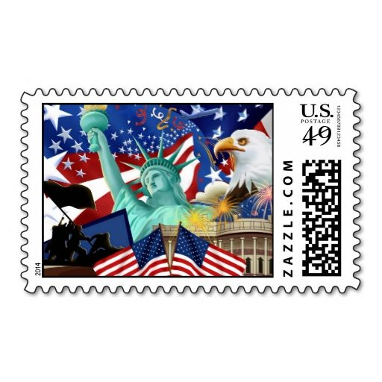
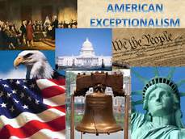
American Exceptionalism
Mythic America

Slide 2
America Exceptionalism: What is it?
The position of the Americans therefore is quite exceptional. Americans have an immense opinion of themselves. Alexis de Tocqueville
Emerson in “American Scholar” calls for a new, distinctly American cultural identity.
We have our mythic history, always upright, generally true but with a bit of embellishment (and ignoring the nasty bits). Individualism is a big deal, along with freedom, democracy, self-reliance, property rights, market economics, and so on.
In the Declaration of Independence, Jefferson used Scottish Enlightenment values (especially John Locke) to focus on the “social contract” of people’s “inalienable rights” to form a government based on freedom and democracy.
Consider “manifest destiny”: the concept of expanding across the entire continent. The term was coined by journalist John O’Sullivan, not by coincidence just before the Mexican-American War.

Slide 3
American Exceptionalism: What is it 2?
What about Woodrow Wilson’s “making the world safe for democracy,” seeking a declaration of war in 1917; then FDR’s “arsenal of democracy” radio broadcast in 1940.
American established the basic global institutions after World War II (you know, the ones a lot of us now hate). Consider the Marshall Plan and NATO. Fighting Communism became a big deal. Somehow that included the McCarthy era, J. Edgar Hoover, and supporting dictators (and overthrowing elected leaders).
“American values” have been part of foreign policy for a hundred years. Unexpected issues included Vietnam, Central America, Columbia, Afghanistan, and Iran.
An alternative perspective is “America First,” which has also been around for most of a century. Congress did not approve the Versailles Treaty after World War I. This is consistent with a “transactional approach” to foreign policy.

Slide 4
The Philatelic Connection
The Post Office/Postal Service has been a willing contributor to exceptional America. What does this mean for history and how we view ourselves? How should they deal with American Exceptionalism?
Beginning in 1957, the Committee Stamp Advisory Committee recommends future stamp issues (usually 25-30 a year). Janet Klug is the current chair.
Before, it seemed more of an ad hoc process. For example, FDR wanted a presidential series and Postmaster General James Farley held a design contest, won by Elaine Rawlinson. All 32 stamps of the series were based on the Rawlinson design.

Slide 5
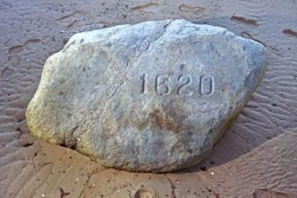
Let’s start with the Pilgrims: Remember Plymouth Rock?

Slide 6
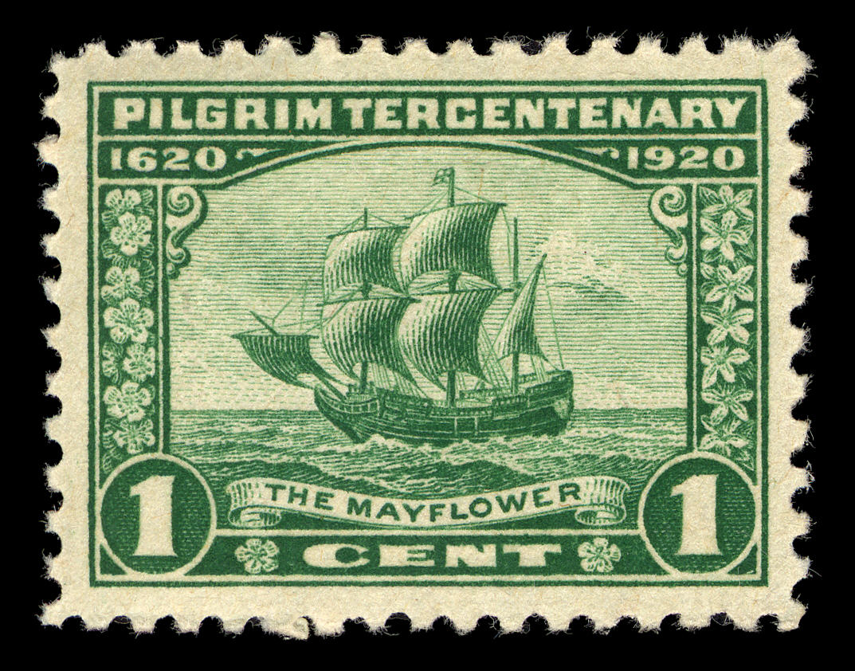
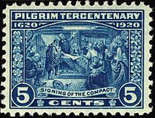
Pilgrim Tercentenary, 1920

Slide 7
What Really Happened?
The Pilgrims never mentioned Plymouth Rock. The first landing was on the tip of Cape Cod near Provincetown in November 1620, then they sailed for a safe harbor in Plymouth Bay. The Pilgrims settled in New Plymouth in December.
The first mention of Plymouth Rock was in 1715 as a town boundary. The rock, a 10-ton boulder, as a landing place was first proposed in 1741.
A piece of the “Rock” broke off in 1774, moved to various locations and only made it back to Plymouth Harbor in 1880.
Apparently, the name “Pilgrims” was first used in Boston in 1798 as part of the Forefathers’ Day celebration.

Slide 8
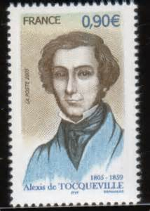
Tocqueville
Alexis de Tocqueville (1805-59), French aristocrat and historian, traveled to America to analyze democracy, which he viewed as a new option and expected to spread around the world. He compared America to France before and after to French Revolution, and considered American exceptionalism (democracy) as a model for rest of world. Tocqueville defined democracy as equality of conditions. Constitution made by Federalists inspired by “aristocratic passions.”
America promotes equality of condition, emphasizing hard work (& focus on
wealth and materialism). Emphasis on New England: religion, focus on education,
importance of townships as vital to development of democracy—a bottom-
up approach (like common law). Note: he also considered problems with
democracy such as the tyranny of the majority, bias against authority,
breeding of high expectations and therefore dissatisfaction.
Patriotism: “devotion to ritual observance;” “irritable patriotism …”

Slide 9
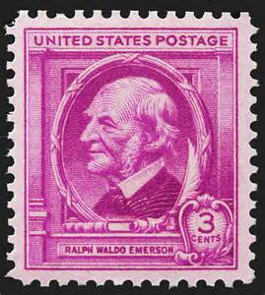
Emerson
As an essayist Ralph Waldo Emerson stressed the uniqueness of America. American writers, scholars, and philosophers should find an American voice, rather than look at European culture.
Emerson found epiphany in nature, became a pantheist and founded transcendentalism.
In “self-reliance” he said to “trust thyself.”
“A foolish consistency is the hobgoblin of little minds.”
“Honor is venerable. It is always ancient virtue.”
“Nothing can bring you peace but the triumph of principles.”

Slide 10
Lincoln Abe Lincoln’s Gettysburg Address described the national purpose “with a new birth of freedom” and preservation of the Union. He stressed the importance of equality. Lincoln’s second inaugural: “ With malice toward none, with charity for all, with firmness in the right as God gives us to see the right, let us strive to finish the work we are in, to bind up the nation’s wounds …”

Slide 11
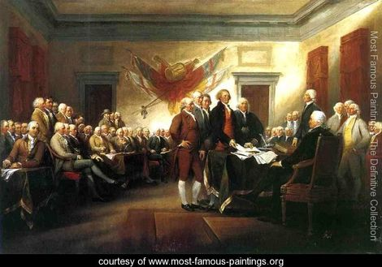
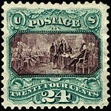
American Revolution: Declaration of Independence (John Trumbull)

Slide 12
Declaration of Independence
The Continental Congress appointed a committee June 11, 1776 to draft a declaration. The process is somewhat unclear, but Thomas Jefferson gets the credit. The committee’s draft was presented on June 28.
Okay, independence was formally declared on July 2, 1776 by Congress. Jefferson’s document was debated, changed substantially (“mangled,” according to Jefferson) and formally passed July 4. [The vote was by state, not individual members.]
Then it was sent to printer John Dunlap, who created the Dunlap broadside which was widely distributed across the colonies.
Jefferson’s original draft is in the Library of Congress.

Slide 13
Declaration of Independence 2
The engrossed copy (carefully handwritten) on parchment was signed over a period of time by the various members, completed in August. This copy is in the National Archives.
The Trumbull picture is great, but this event—the member of the committee presenting the document to the full Congress presided over by John Hancock never happened. Many members of Congress ultimately signing the document were not in Philadelphia on July 4.
Trumbull and Jefferson blocked out the painting in 1784 in Paris (in Jefferson’s study); the point was to capture an accurate portrait of every signer of the document. Trumbull went on the paint a series of portraits and Revolution events.
Key point: the picture captures the importance of the Declaration of Independence—this is what should have happened. The Post Office never claimed this was historically accurate, only presented a painting that is probably the most famous in America.

Slide 14
American Revolution: Washington Crossing the Delaware (Emmanuel Leutze)

Slide 15
The Battle of Trenton
No question, this was a big deal. Granted, a tiny victory, but it came at a key time. The successful surprise attack on the Hessians at Trenton on the morning of Dec. 26, 1776 was needed to keep the army in the field as many enlistments were up and soldiers were expected to leave rather than stay in an unsuccessful army—Washington was badly defeated trying to defend New York earlier in the year.
Washington and his troops did cross the icy Hudson River on Christmas night. However, they made the trip in whatever they could find, especially barges, large ferries and “ Durham boats” normally used to transport heavy loads from Durham Iron Works.
On the return trip, apparently large numbers of troops had to be pulled from the river after plundering Hessian rum. There is no evidence that Washington looked prominently heroic in the crossing.
The Leutze painting: no doubt, this is how it should have looked.

Slide 16
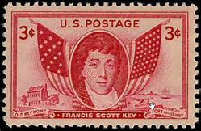
The National Anthem
Francis Scott Key & the Star-Spangled Banner; Key, a lawyer, was aboard a British ship to negotiate a prisoner exchange and witnessed the attack of Fort McHenry. When he saw the American flag still flying in the morning he wrote the poem “The Defense of Fort McHenry.” This (after adding a British drinking tune) became the national anthem in 1916 (executive order by Woodrow Wilson).

Slide 17
Great American Events
There are many things for which Americans can be justly proud, without any hype or massaging the truth.
Partial list: Bill of Rights (1791); Lewis & Clark (1804); Erie Canal (1825); Gettysburg Address (1863); Marshall Plan (1947), Civil Rights Act (1964), Sandra Day O’Conner, the first woman Supreme Court justice (1981), Neil Armstrong walks on the moon (1969).
Near misses: US Constitution (1788; problem: did not solve slavery);Transcontinental Railroad (1869, ignoring corruption such as Credit Mobilier); FDR and much of the New Deal (1933—plenty of failures, lots of experimentation, and conservatives were not all in).

Slide 18
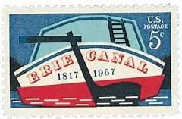
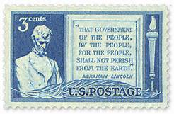
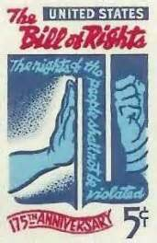
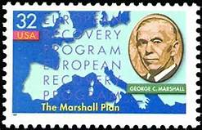
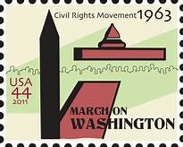
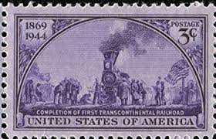
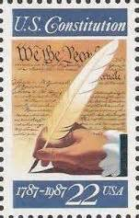
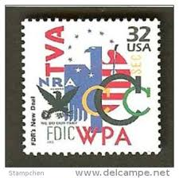
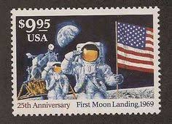
Great American Events

Slide 19
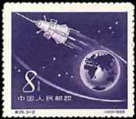
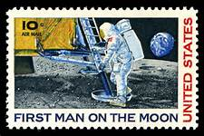
Sputnik, then Earthrise over the Moon, 1968 and Moon Landing, 1969

Slide 20
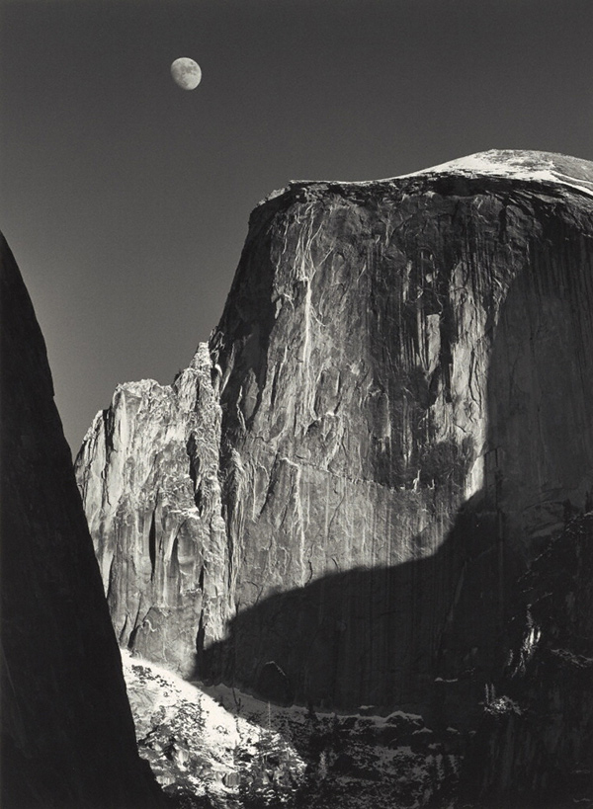
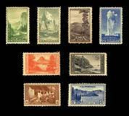
National Parks, Ansel Adams & Stamps

Slide 21
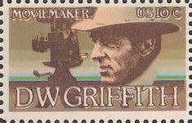
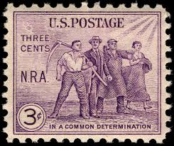
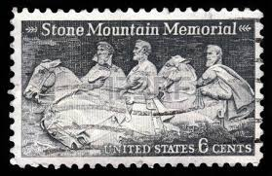
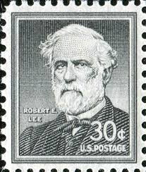
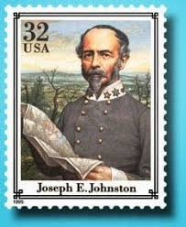
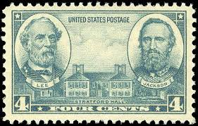
Maybe Not
DW Griffith: Director of NRA: Declared Confederate
Birth of a Nation Unconstitutional Generals

Slide 22
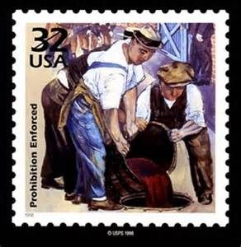
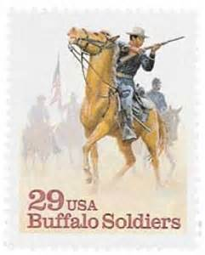
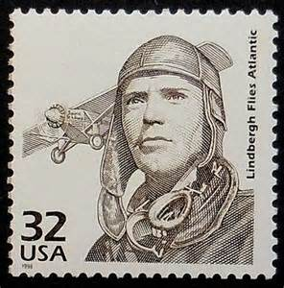
Interesting
Prohibition Buffalo Soldiers Charles Lindbergh
What about: J. Edgar Hoover, Alexis de Tocqueville, Robert Morris, Aaron Burr, Huey Long, Joe McCarthy, Texas Rangers, First Bank of the United States, Billy the Kid?

Slide 23
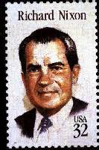
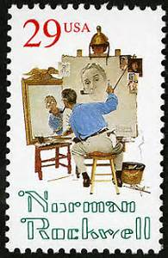
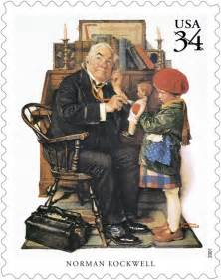
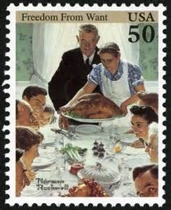
Still Interesting
Normal Rockwell Nixon

Slide 24
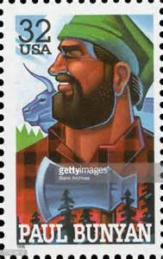
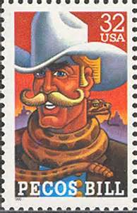
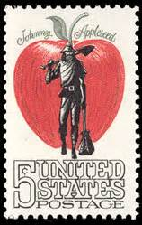
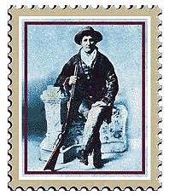
Mythic Characters: Real or Not
Paul Bunyan Johnny Appleseed Pecos Bill Calamity Jane

Slide 25
Legends of the West Who belongs?

